Slide 1
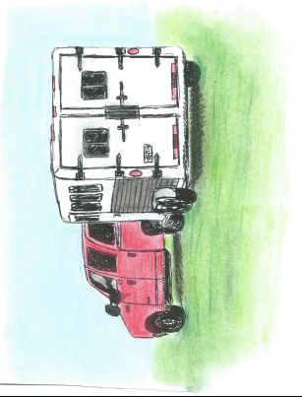
LET’S RODEO!
Written and Illustrated by Taylor Day Pearce
Published by Southern Instructional Solutions, 2015
for the Homestead Rodeo Association’s
Books & Broncs Literacy Project

Slide 2
Copyright © 2015 by Southern Instructional Solutions
All rights reserved. NO part of this publication may be sold, reproduced, distributed, or transmitted in any form or by any means, including photocopying except for educational purposes, recording, or other electronic or mechanical methods, without the prior written permission of the publisher, except in the case of brief quotations embodied in critical reviews and certain other noncommercial uses permitted by copyright law. For permission requests, write to the publisher: SouthernInstructionalSolutions@aol.com
The book, Let’s Rodeo! was written and illustrated specifically for the Homestead Rodeo Association to use as part of their Books and Broncs Literacy Project. Outside of the Association, this book may be used for educational purposes only. If it is going to be duplicated, make sure that all its content remain intact which includes the cover page, dedication, about the author/illustrator, and the copyright information page.

Slide 3
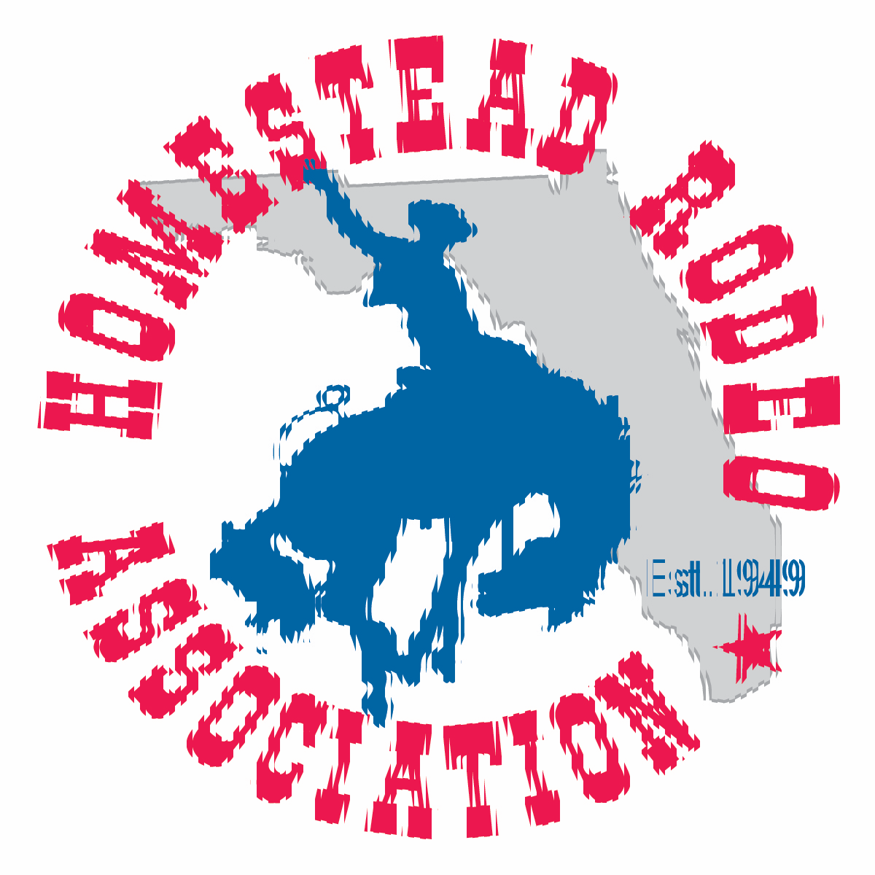
Dedicated to…
The Homestead Rodeo Association’s
Books & Broncs Literacy Project, 2015.
Thank you for reaching out to all children to share the rodeo life experience which occurs right here in South Florida
every year.

Slide 4
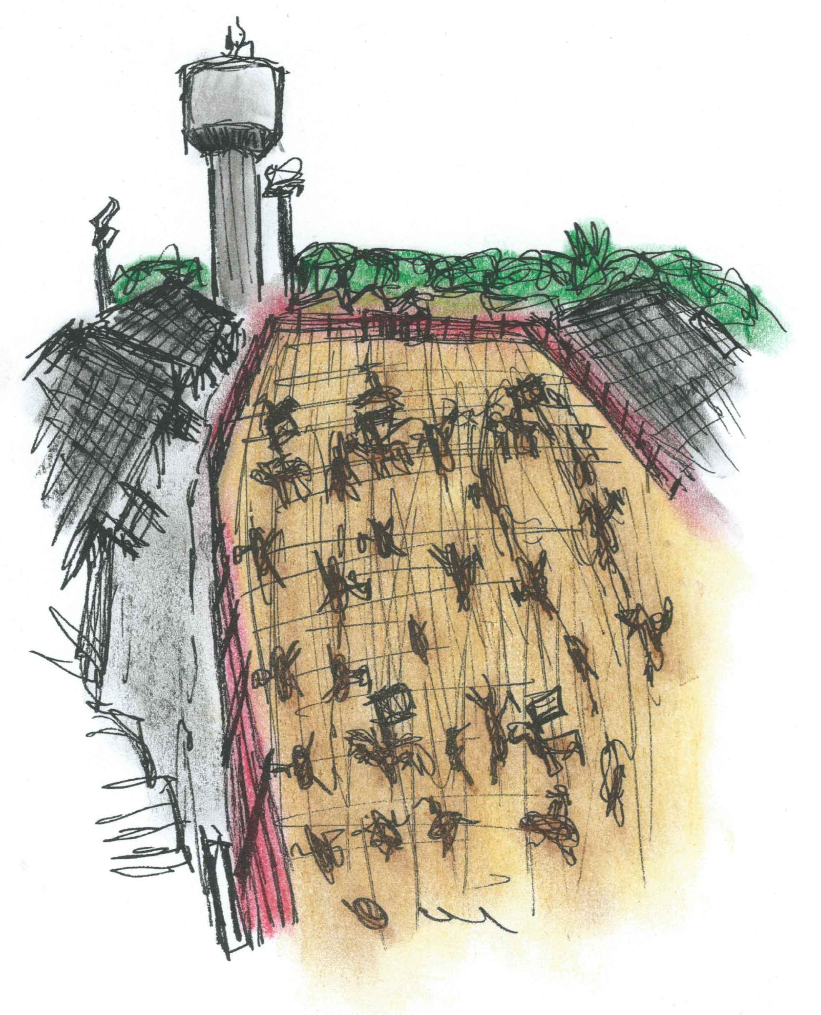
Do you want to know about the rodeo? This only happens once a year. Hear the crowd clap and cheer! Look how the cowboys and cowgirls ride in Watch the Grand Entry; let’s see who will win!
Notes:
Casper the Clown

Slide 5
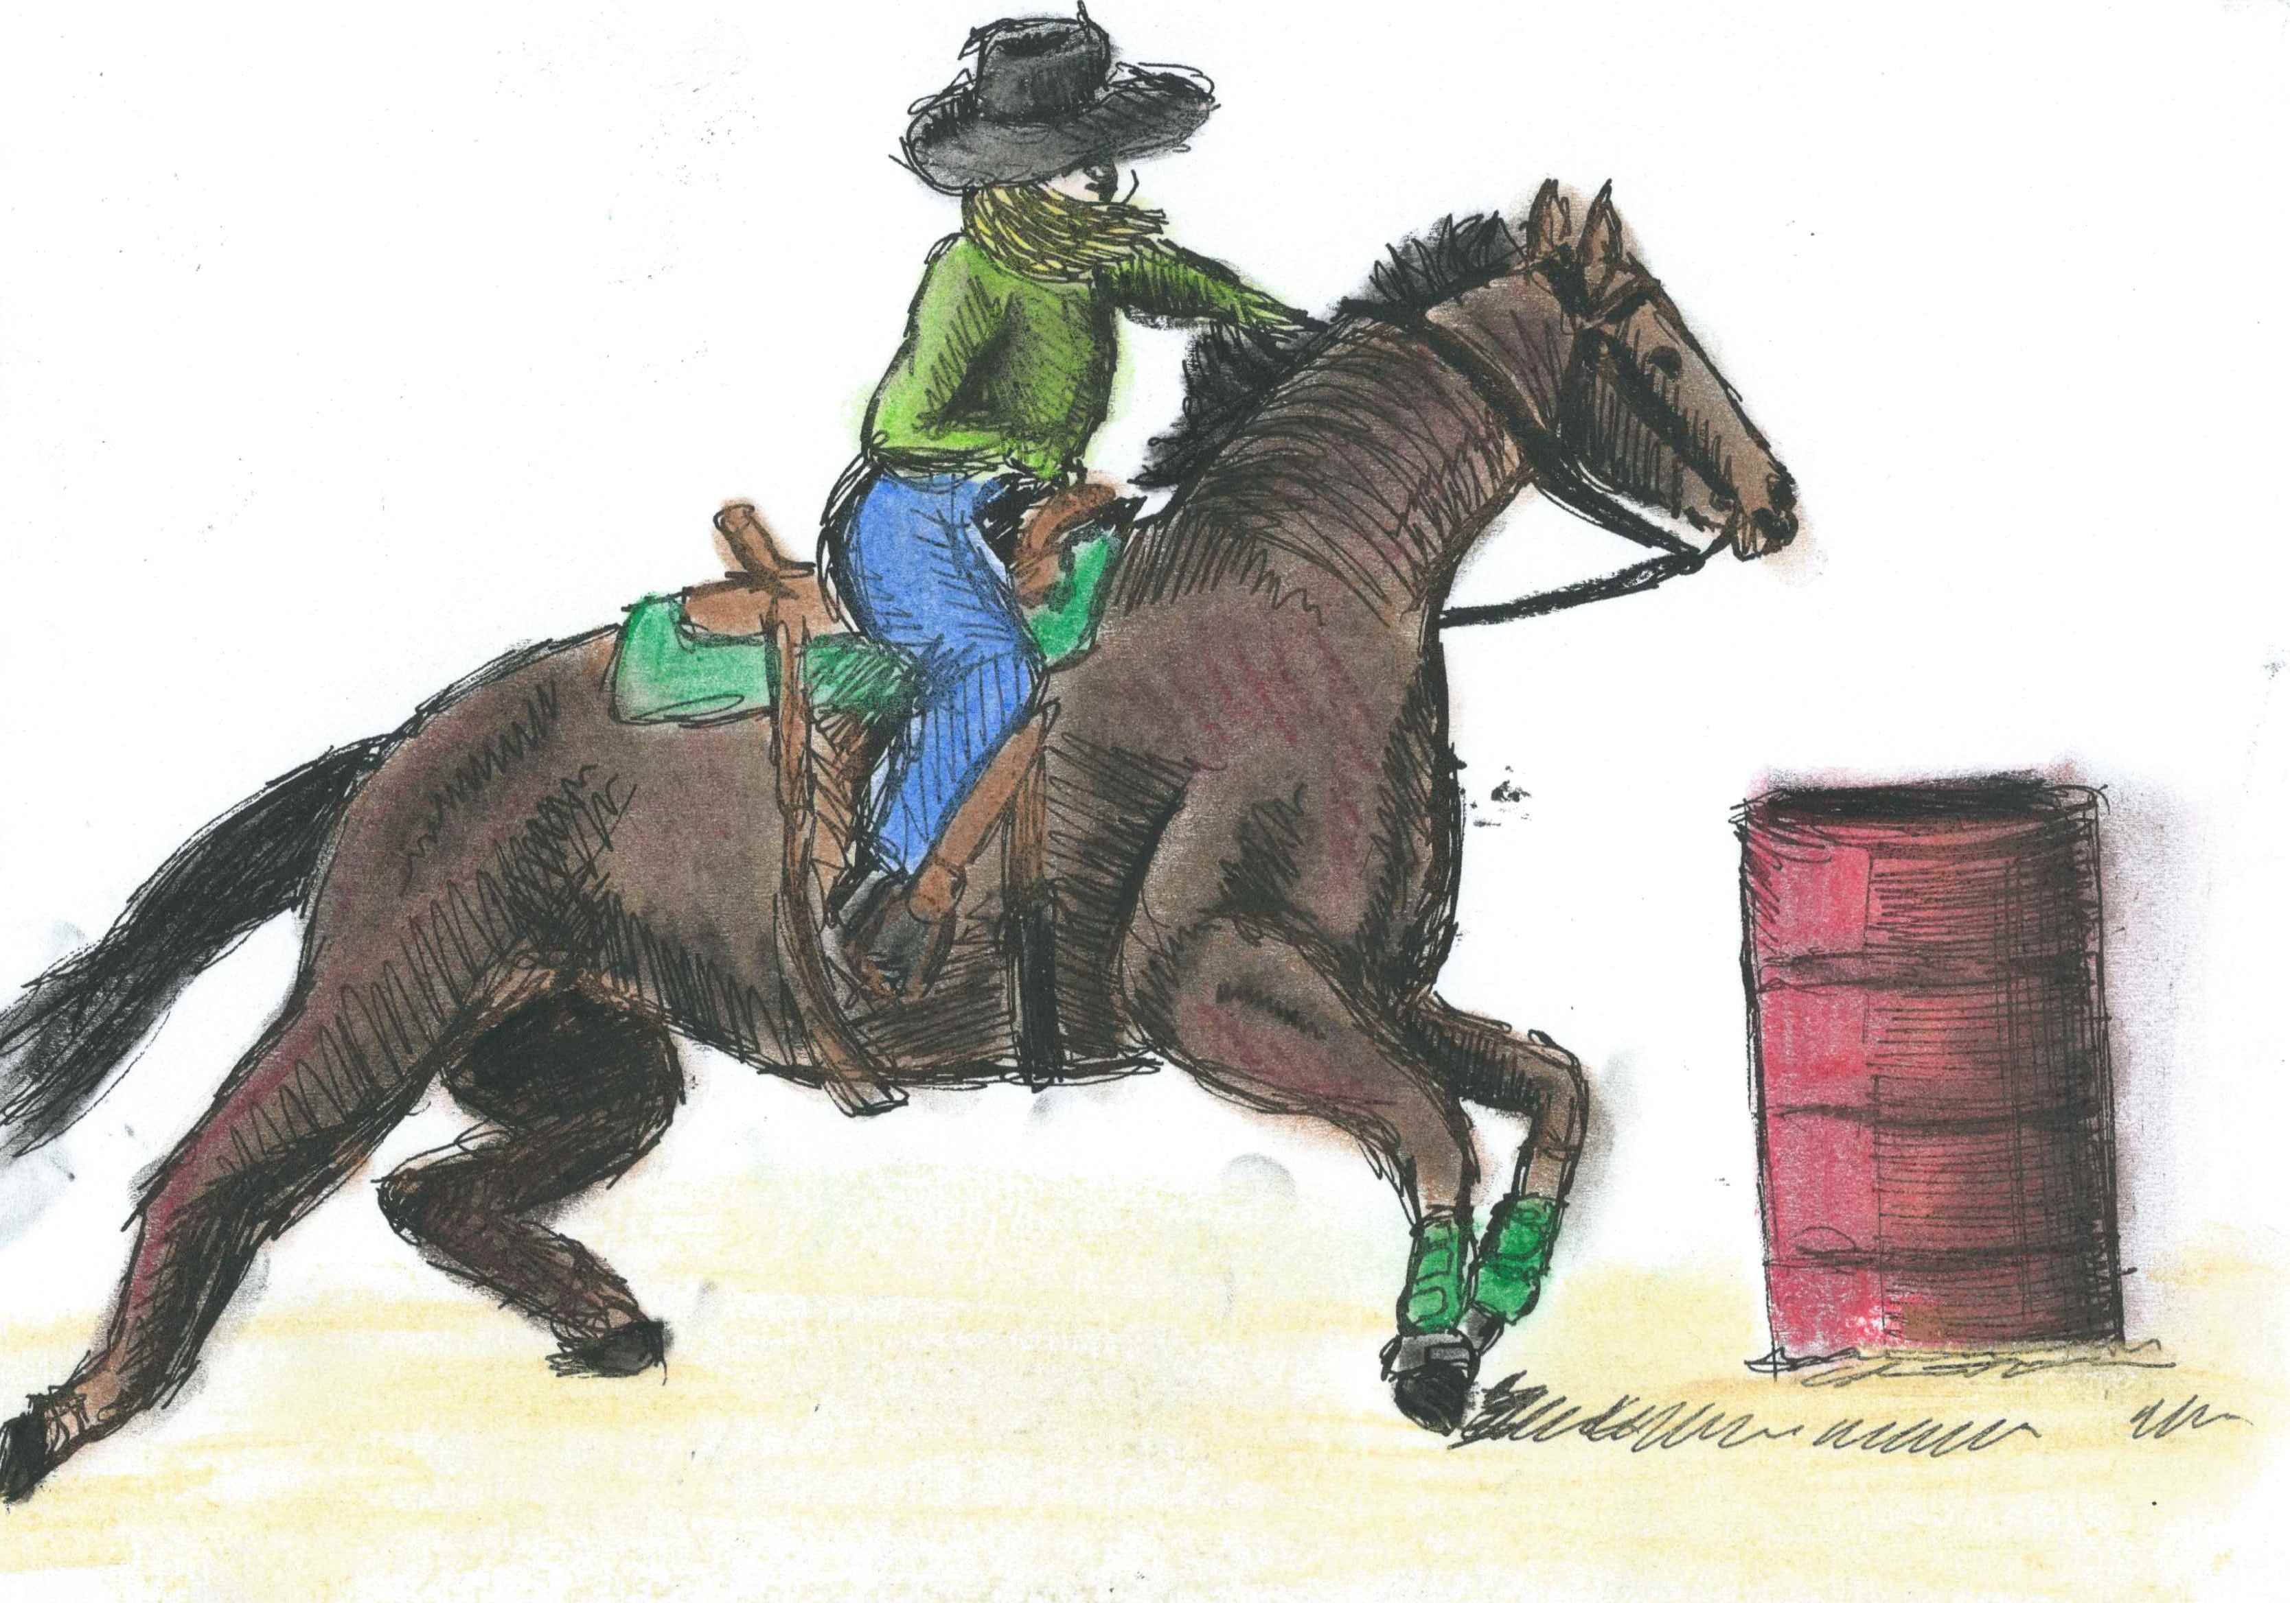
Barrel racing begins, as the crowd takes their seats And cheers them on by stomping their feet. The cowgirls kick, as their horses fly, Around three barrels, under the bright sky. A sport like this takes great skill and balance, To show off all the cowgirl’s talent!
Notes:
Barrel Racing

Slide 6
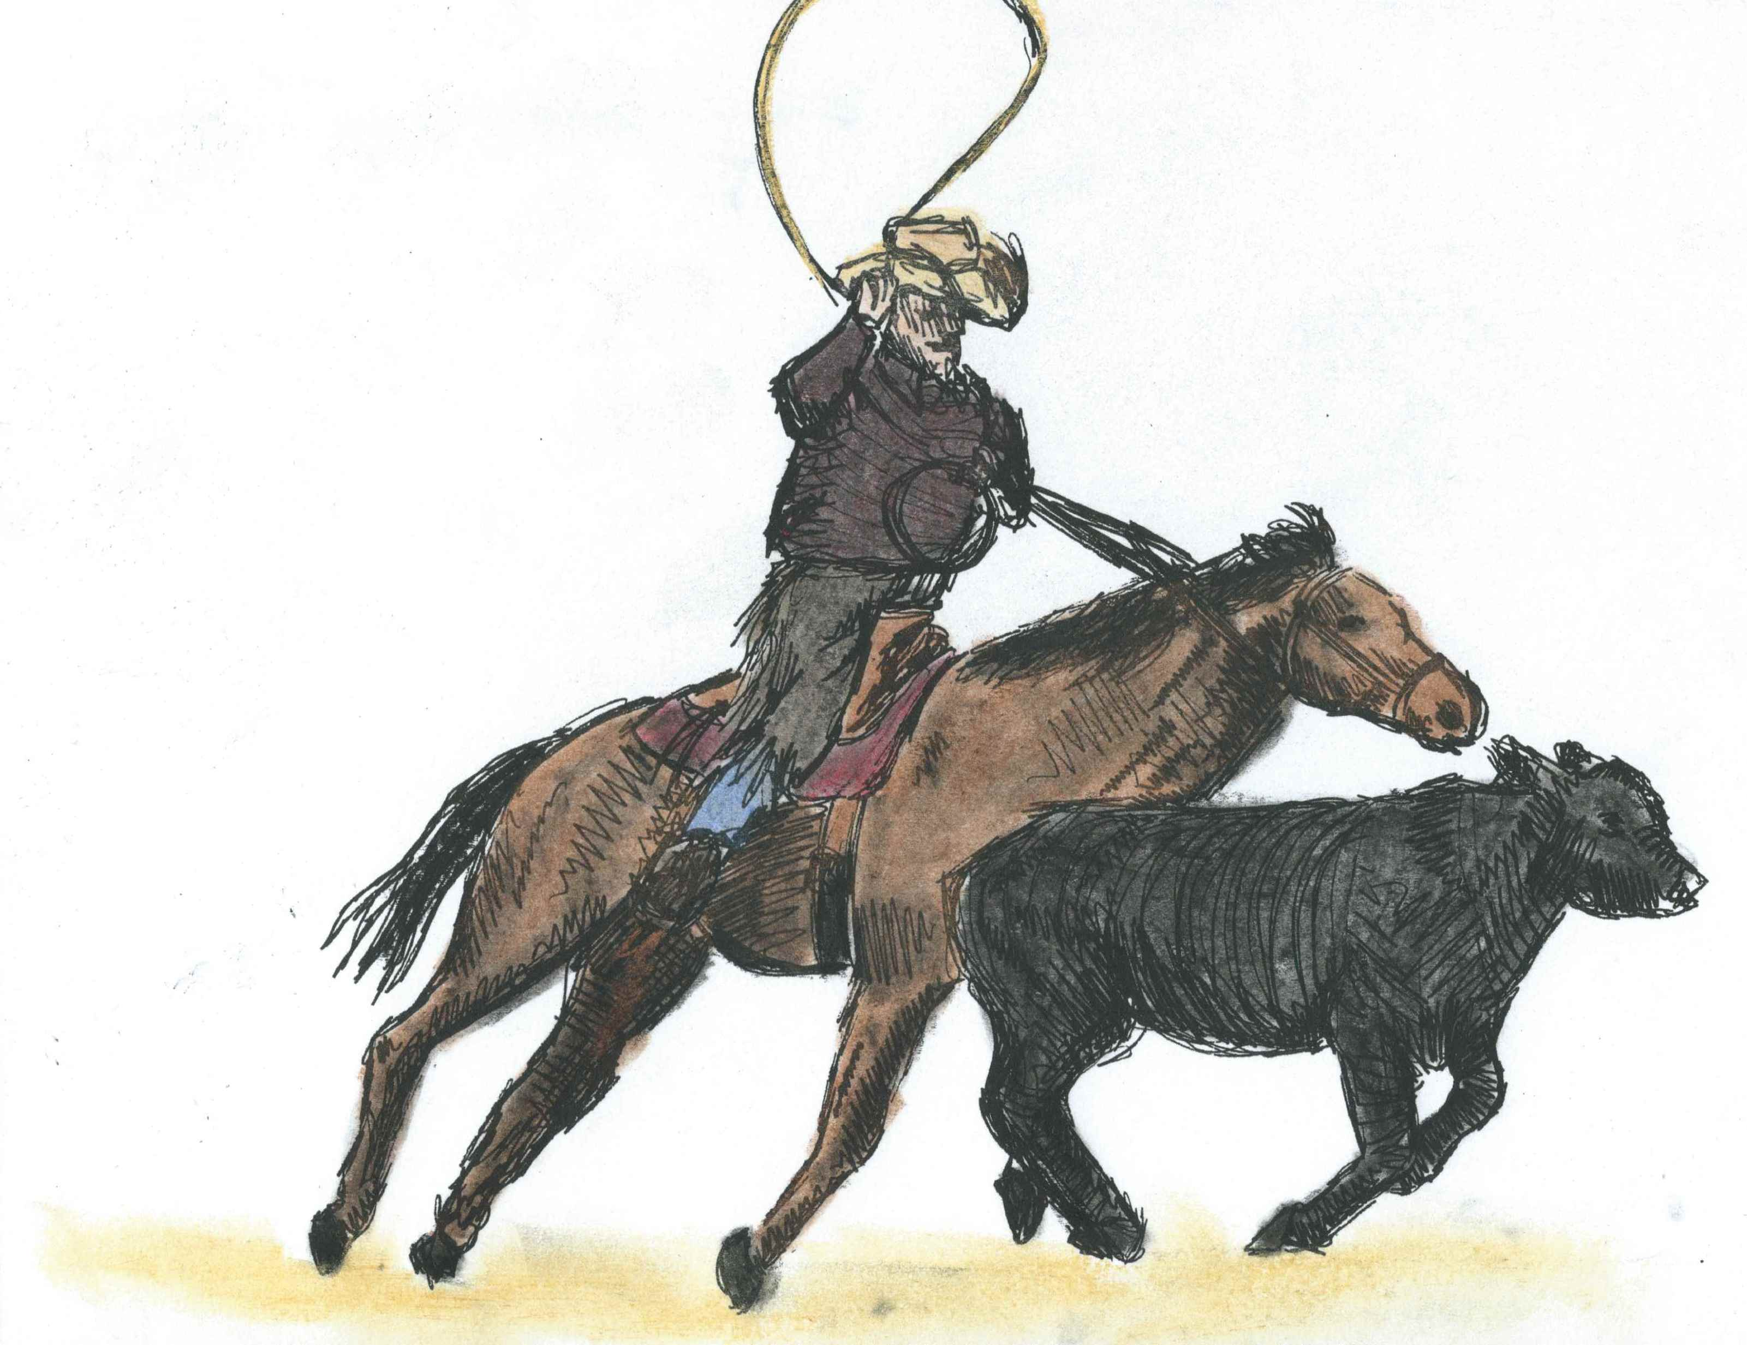
Out the chute the cowboy’s horse runs Rope in hand, the timers begun, Chasing the calf through the arena, Swinging the rope like nobody has seen ya’, Catching the head and jumping off quick To flank the calf down and tie with no kicks!
Notes:
Calf Roping

Slide 7
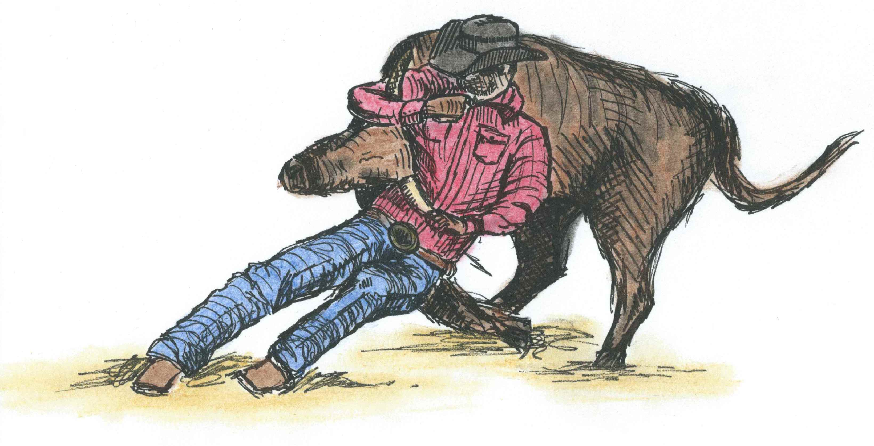
Look down the arena and what do you see? But a bull-dogging rider coming straight at me! The steer is a running with cowboys penned in Slipping from his horse, one jumps on him! Screeching on the breaks with his boots out front Then rolling that cow until his body just slumps.
Notes:
Steer Wrestling – Bull Doggin

Slide 8
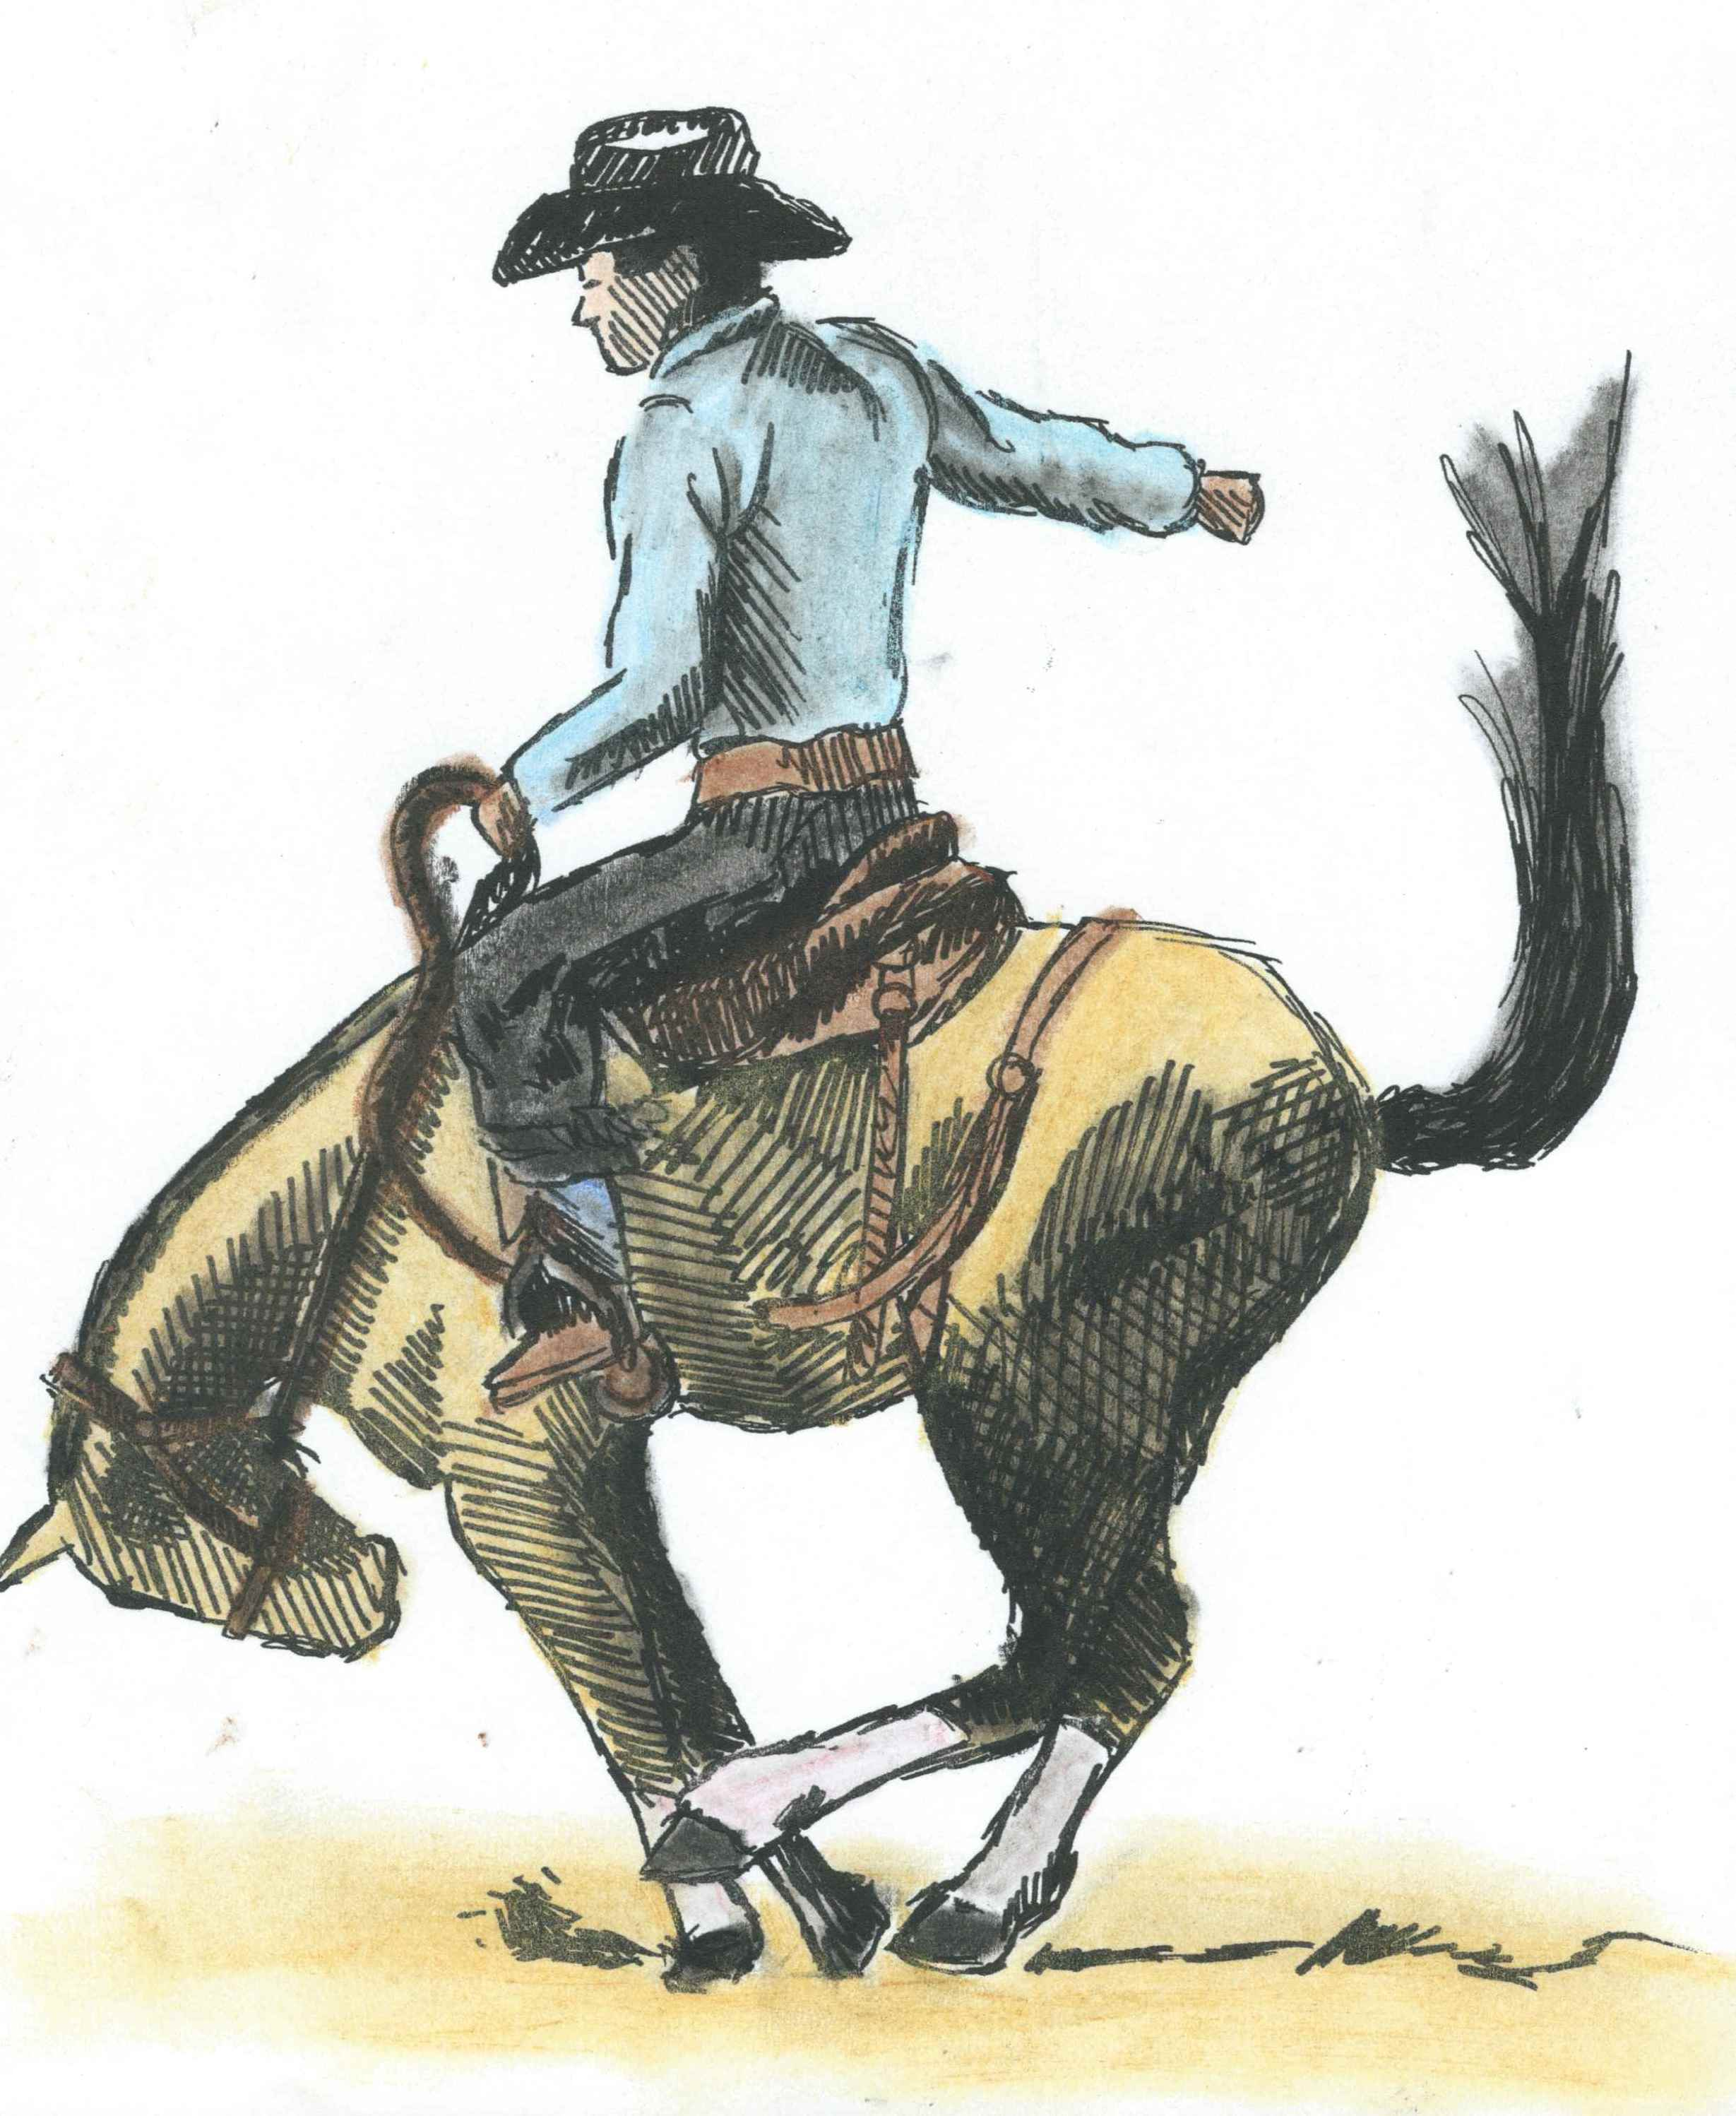
The next wild ride you’d be waiting to see Is the cowboy and the bronc running free. Holding that saddle with a hand in the air The spurs are a kicking and the bronc doesn’t care. With the jumping and the spins and just holding on tight You’d think that the cowboy would be scared for his life!
Notes:
Saddle Bronc

Slide 9
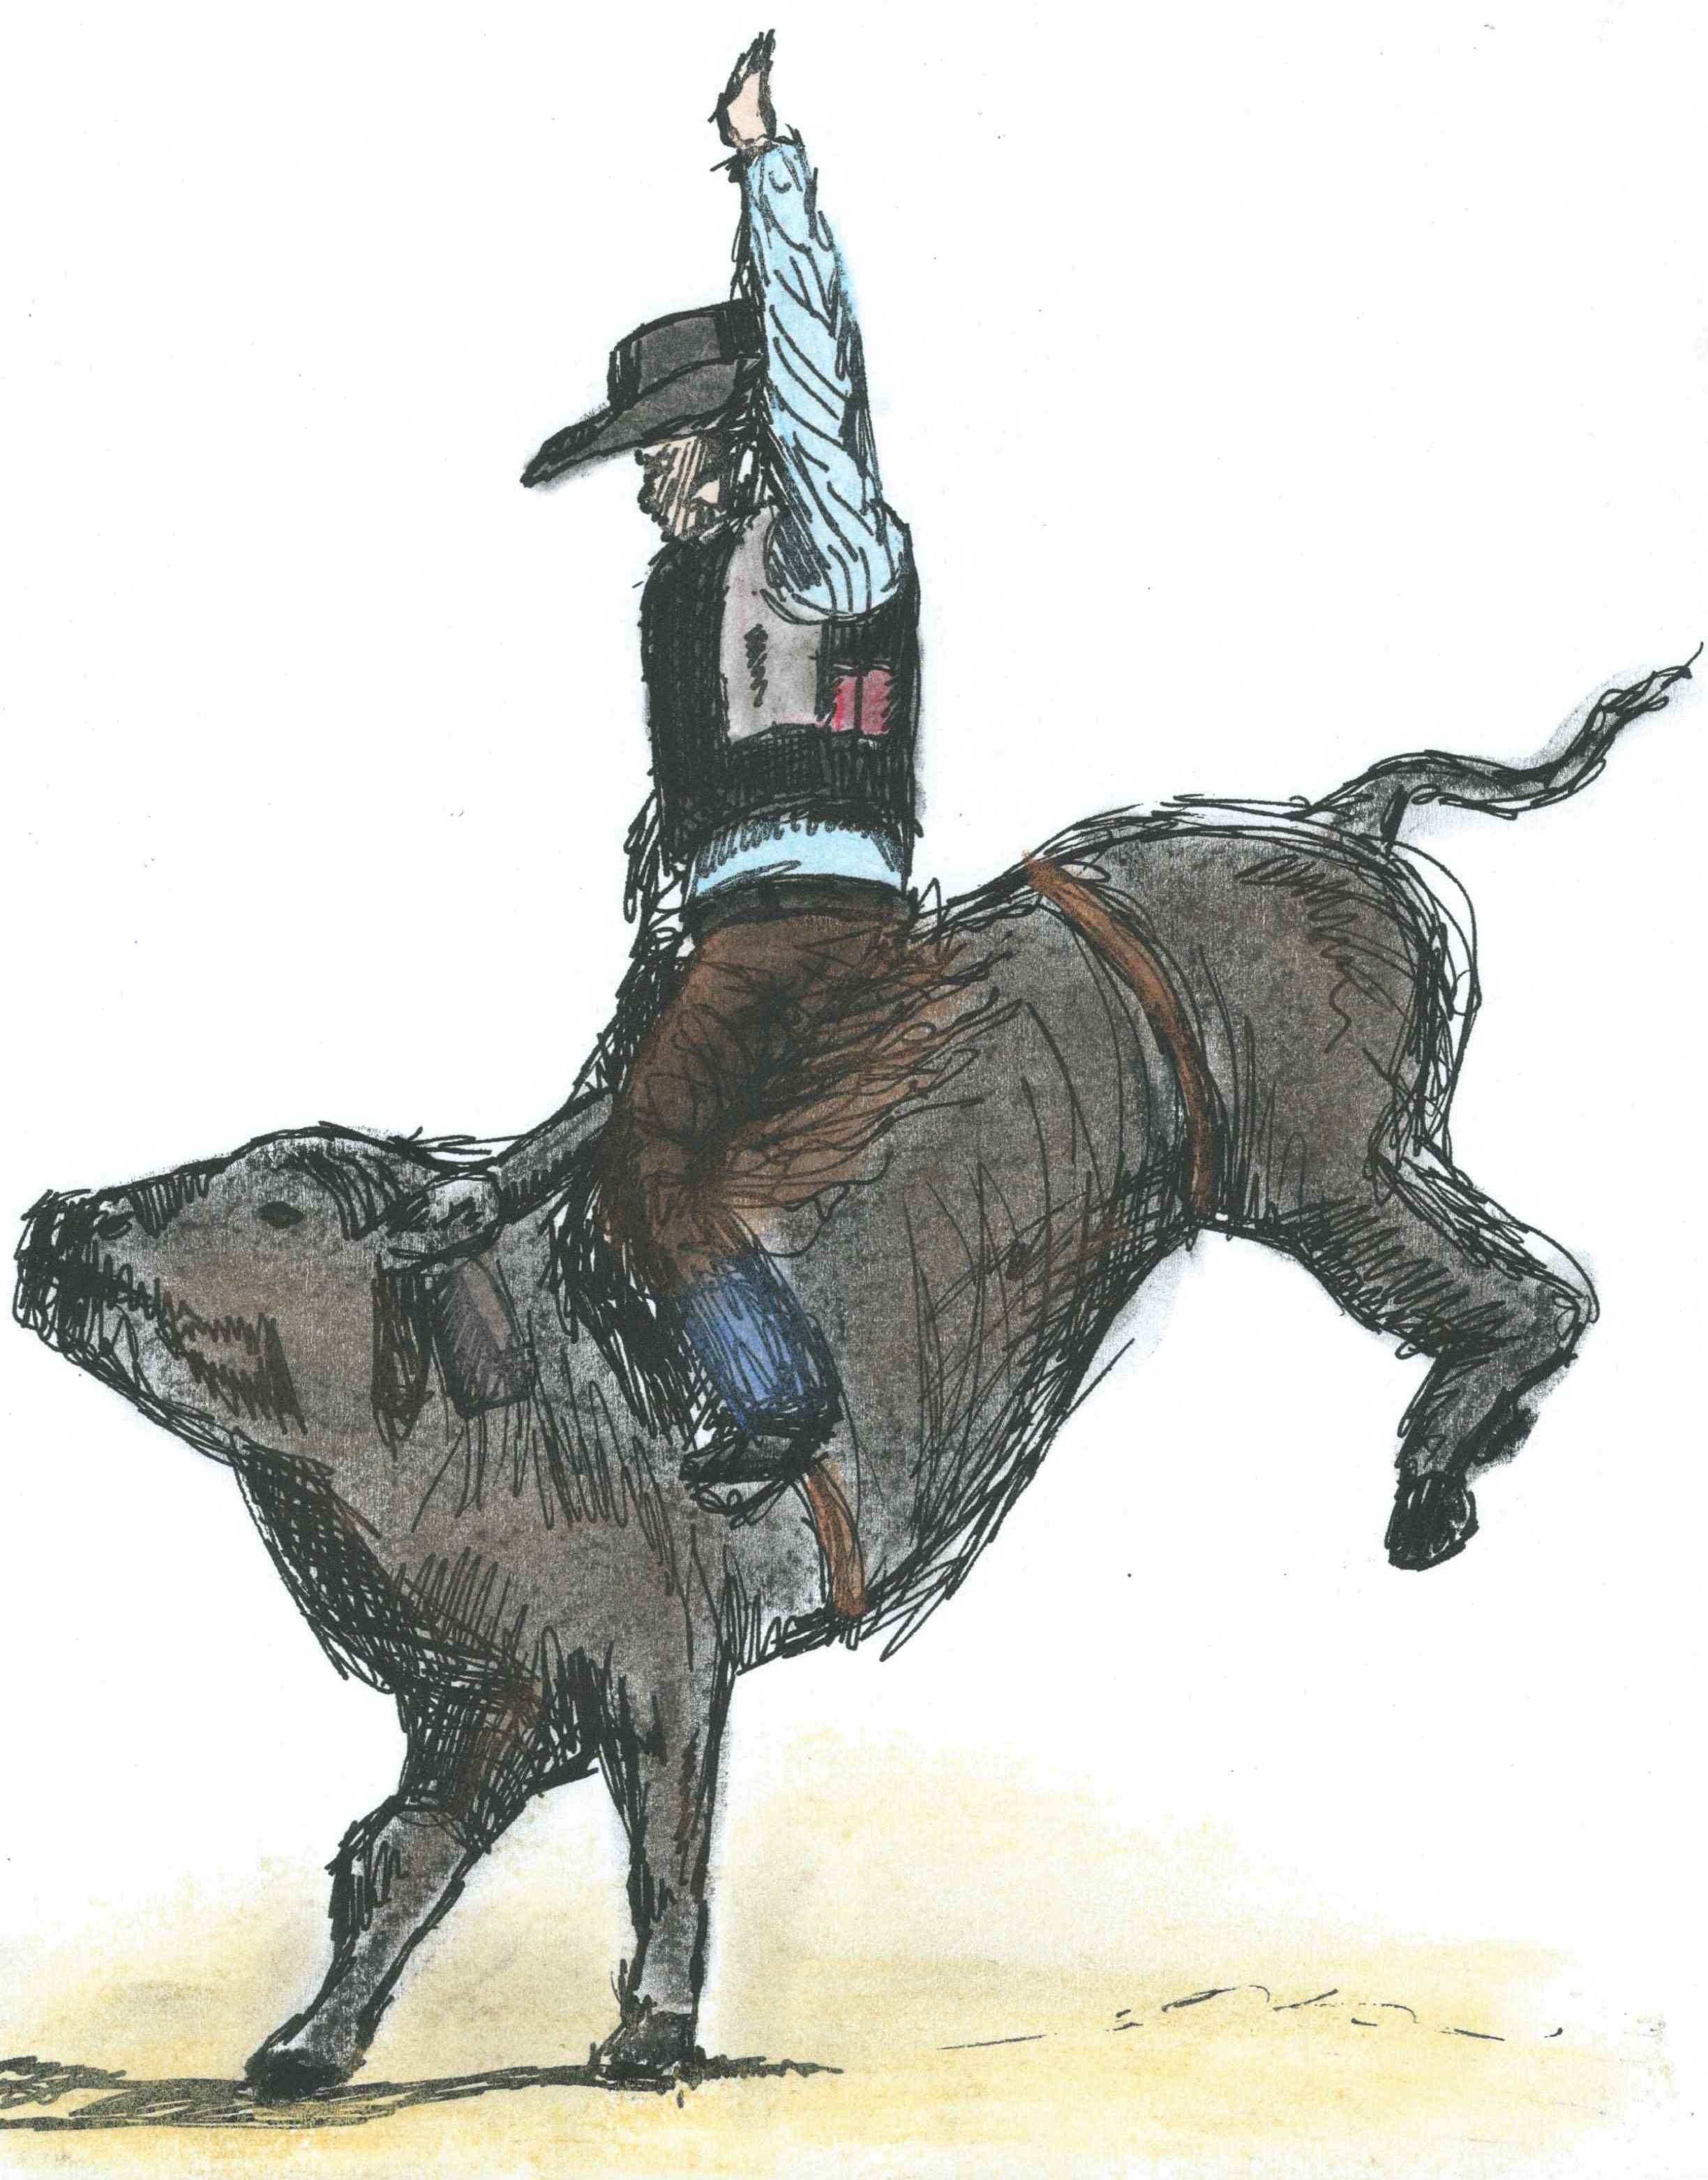
Don’t blink or you may not see Bull riding in action, is the place to be . The cowboy hangs on, holding tight with one hand, Hoping he does not hit the sand. Eight seconds later, when the buzzer sounds, The rider jumps and runs off the battle ground.

Slide 10
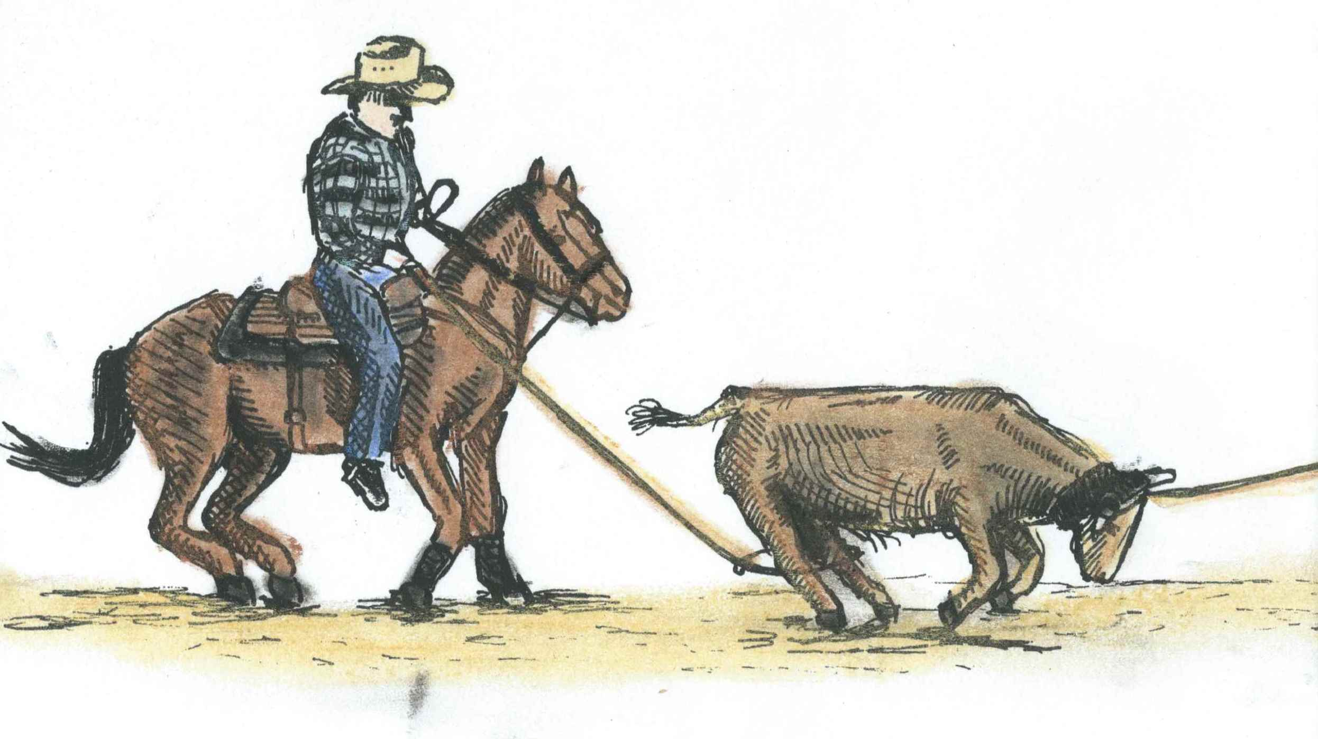
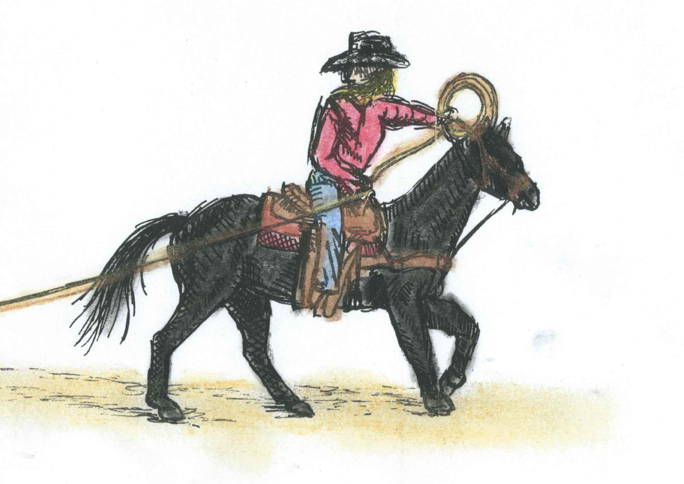
When the header nods, the chute is open, Out the steer runs with the header roping. The team swings their ropes round-and-round The steer is caught and no one makes a sound. It’s time for the heeler to take his ring Hooking those hooves, pull tight that swing!
Notes:
Team Roping

Slide 11
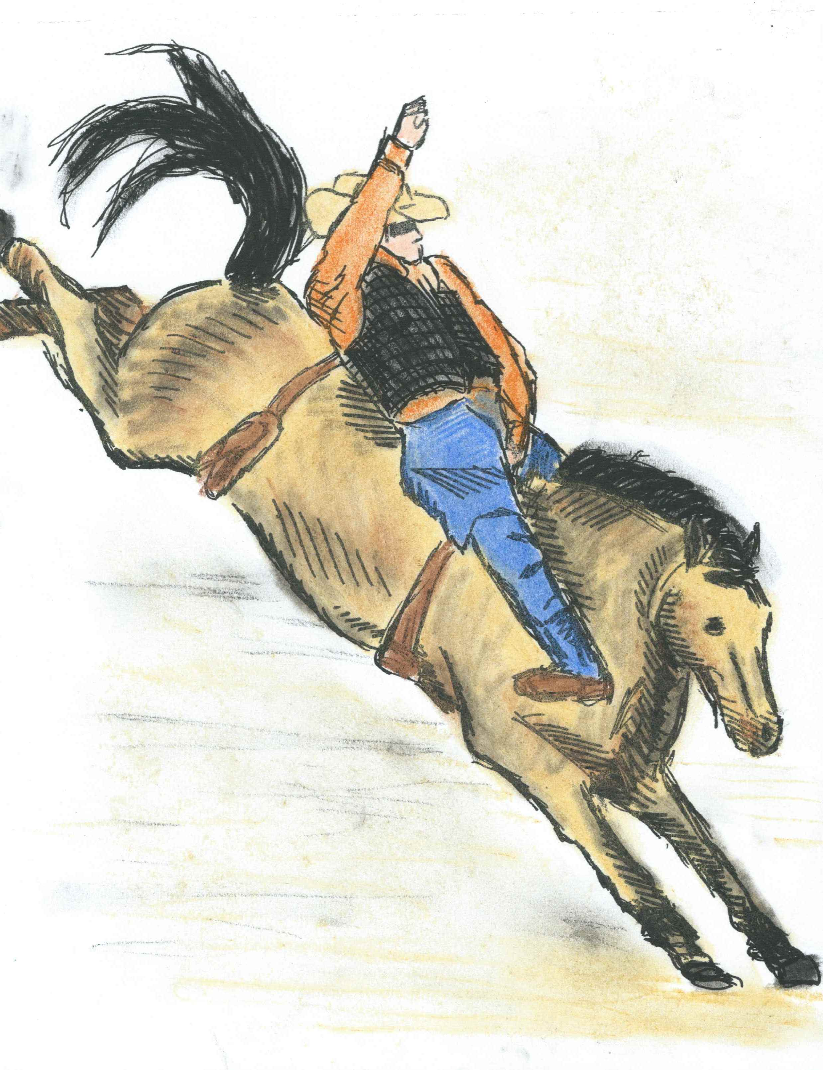
Just like any other event Bareback can be very intense! With no saddle, riders hold on tight, As they are in for a very big fight. Just like saddle broncs go round-and-round, The cowboy riding bareback, will soon hit the ground.
Notes:
Bareback Bronc

Slide 12
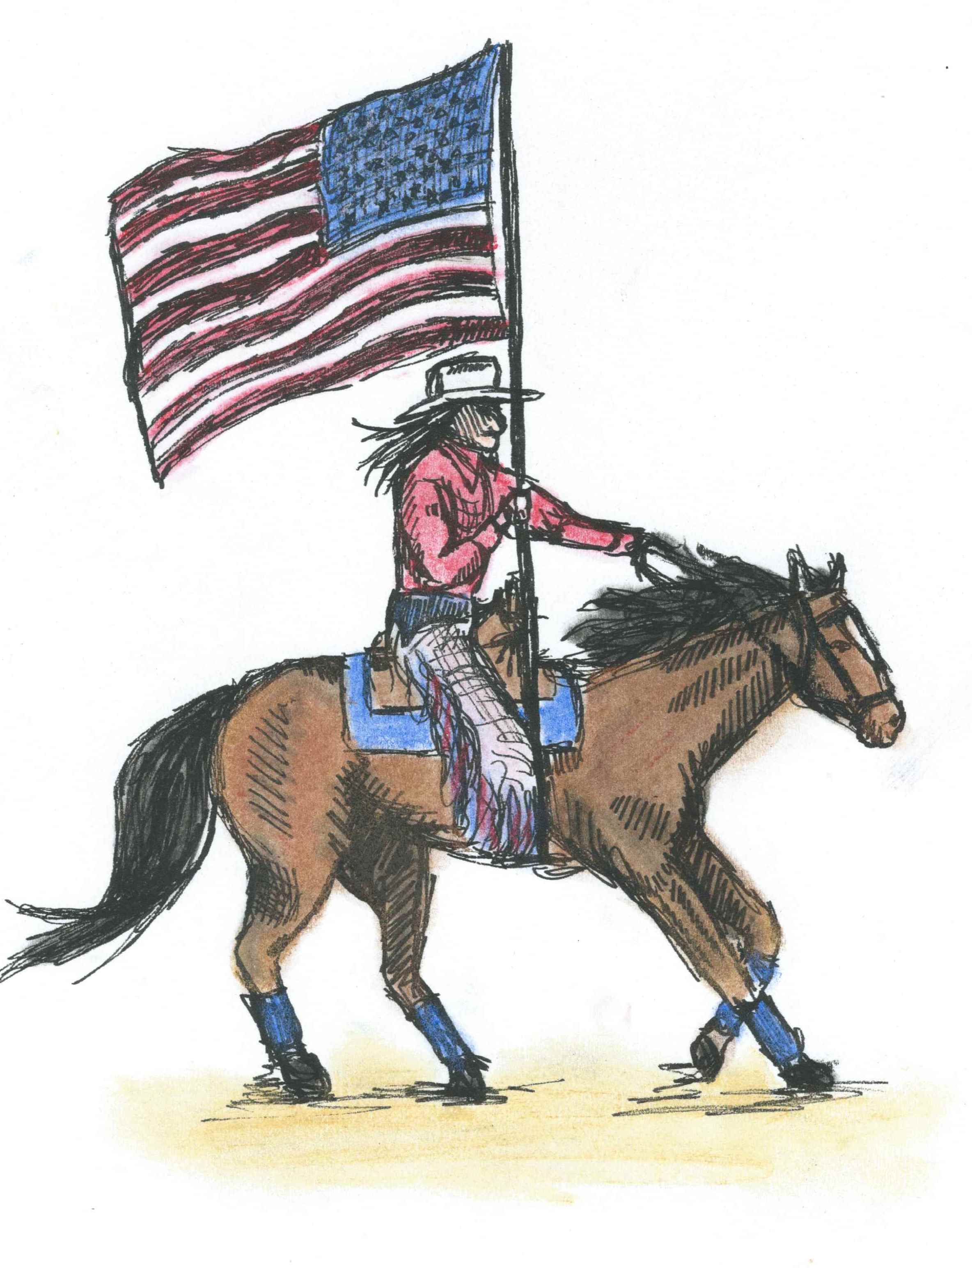
Before you know it, it’s the half time show When the drill team enters, with a glitter-and-a-glow. With the flags flying high, and music in the air, The riders come in with a special flair. The patterns you see take great practice and skill You’ll be amazed by the horse and rider’s will.

Slide 13
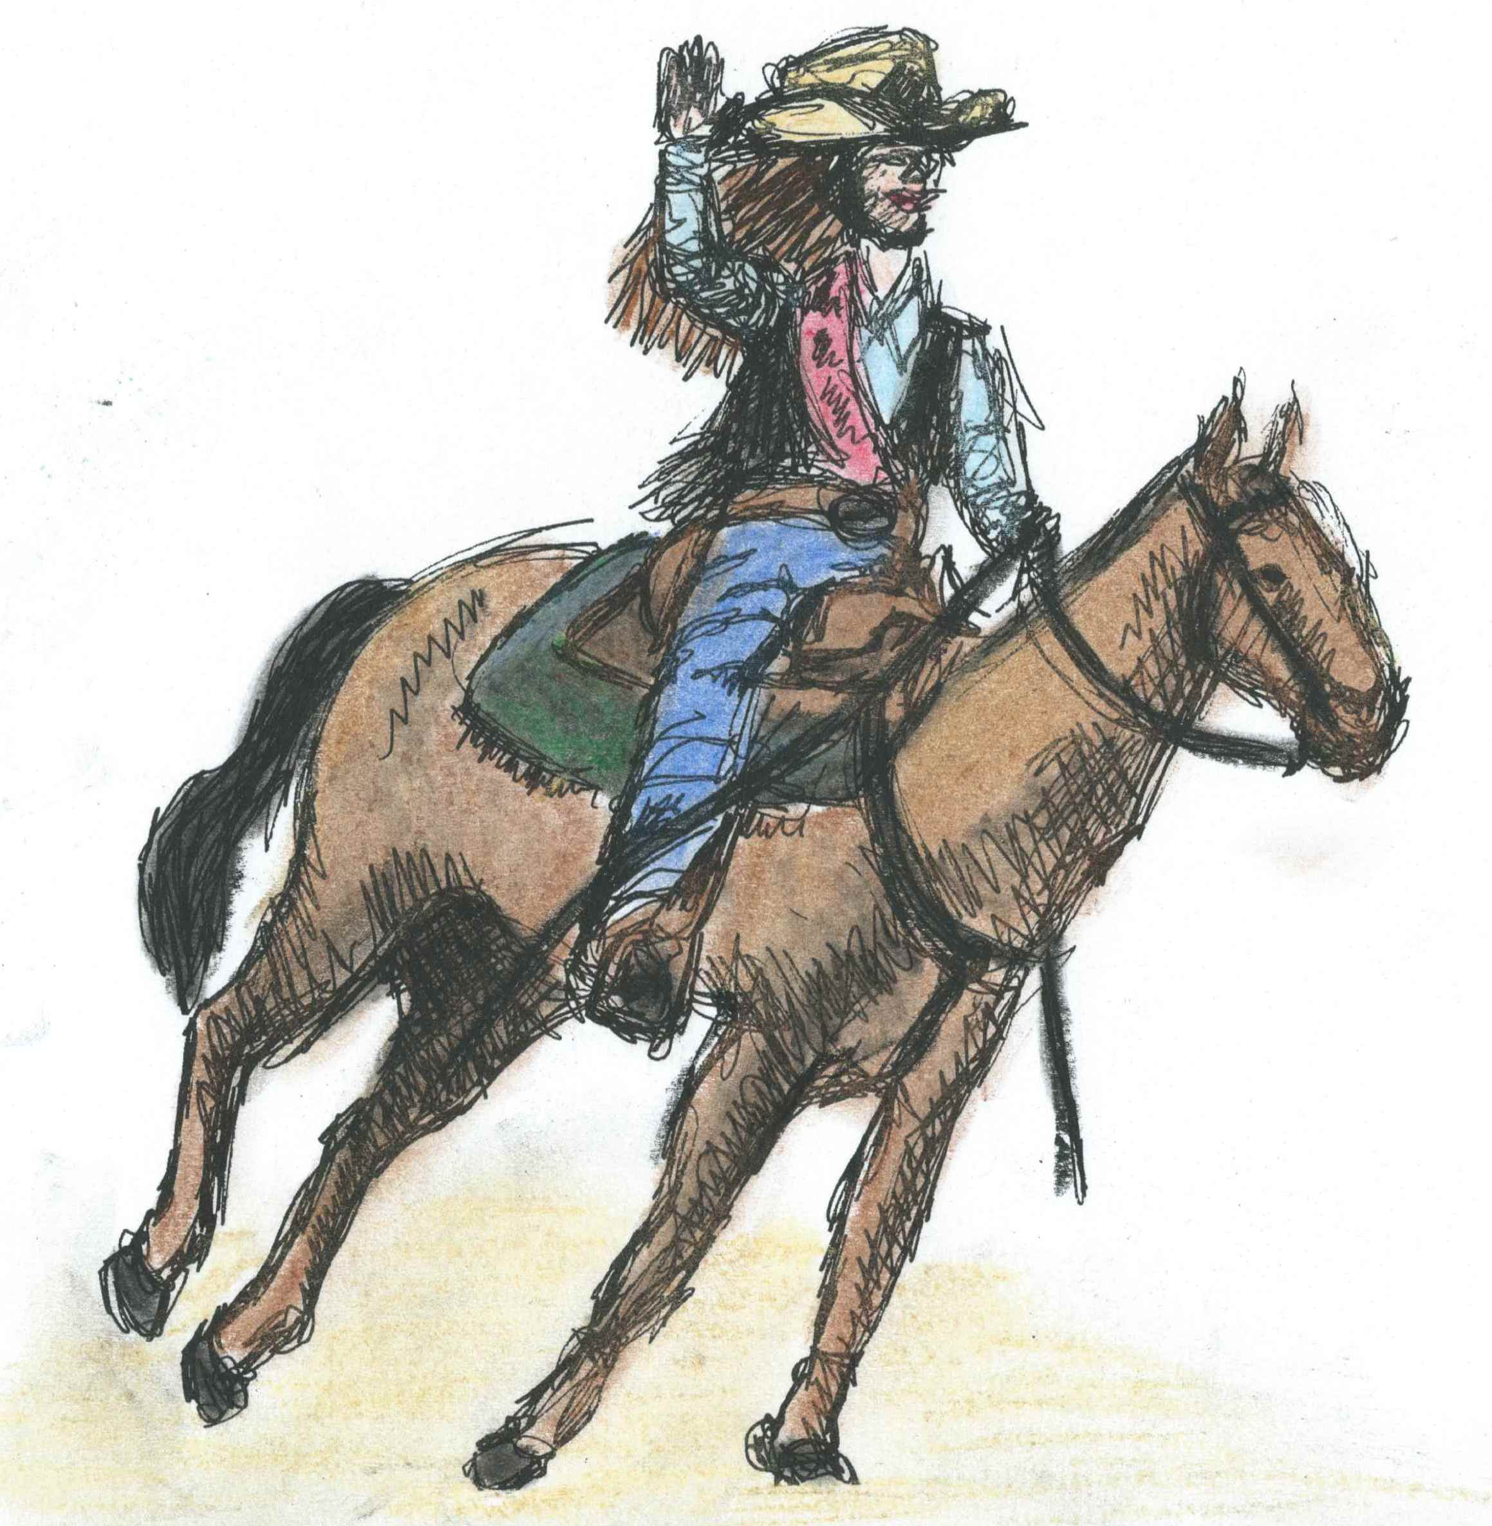
In-between these exciting events, during the half time show, The announcer introduces the queen of the rodeo. Along with the queen is her court, on which she leans, For a year of volunteering and work to be seen, Wearing crowns on hats and sparkly shirts, Down to belt buckle jeans and boots without dirt.

Slide 14
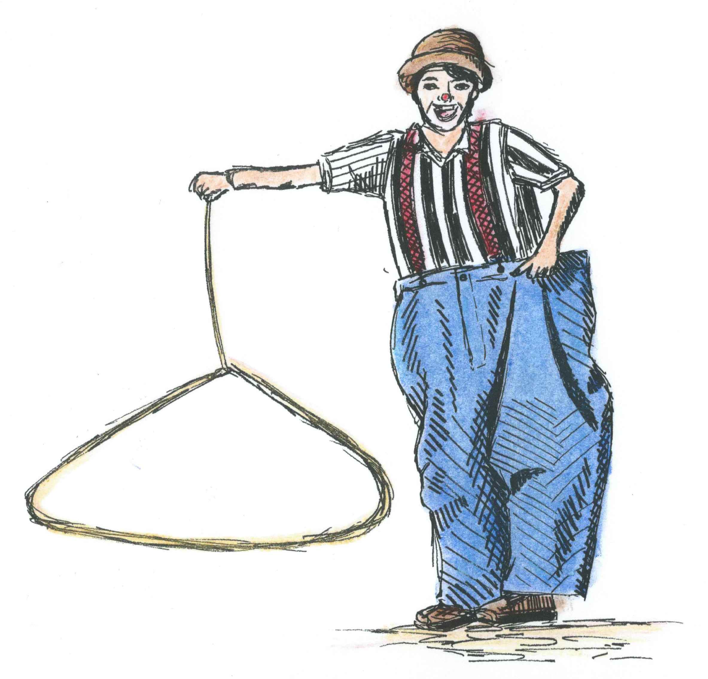
What is the cause of all the laughter I hear? Why, the rodeo clown has now appeared! A funny looking man with a big hat and overalls Entertains the crowd with a holler and a call! With skits and jokes that make us crack, I sure hope next year he’s back!

Slide 15
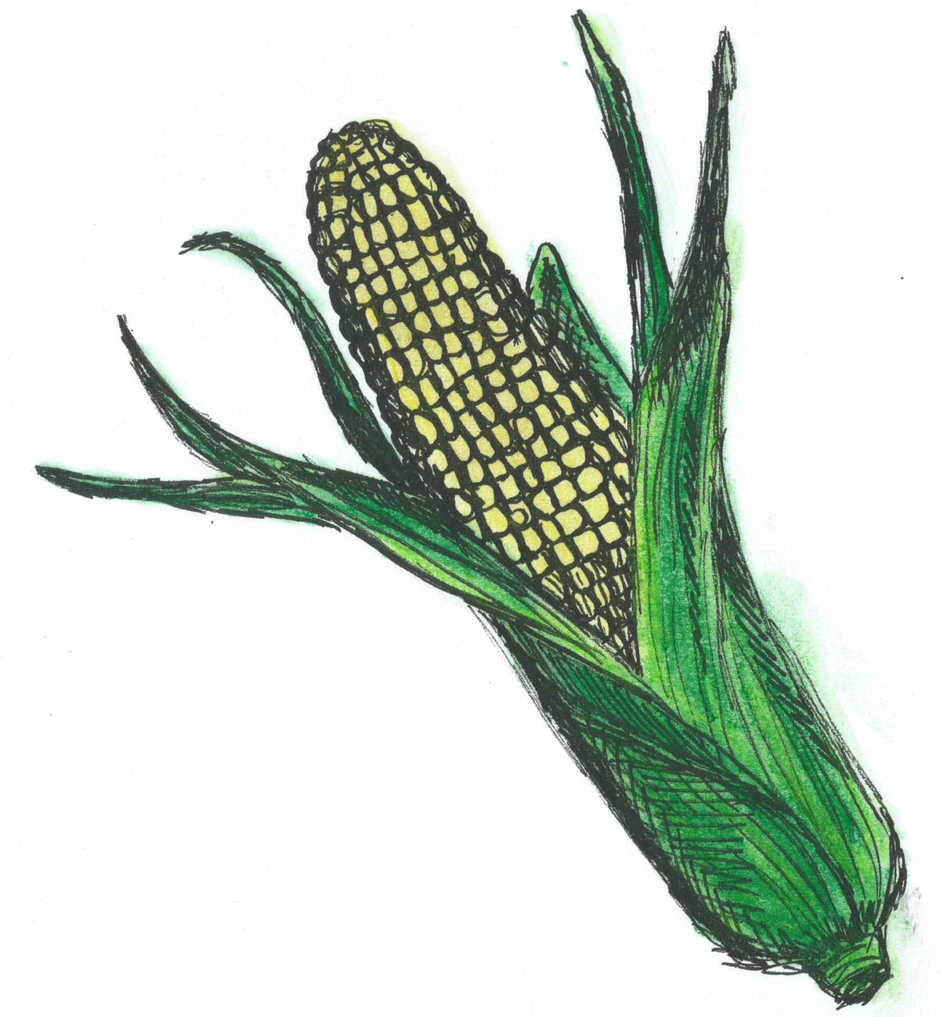
Many good smells come to my nose, The hustle and bustle does not slow. As the crowd retreats for the yummy food That will put us all in a good mood. Eating corn-on-the-cob, funnel cake, and snow cones; So many choices, if I only had these at home.

Slide 16
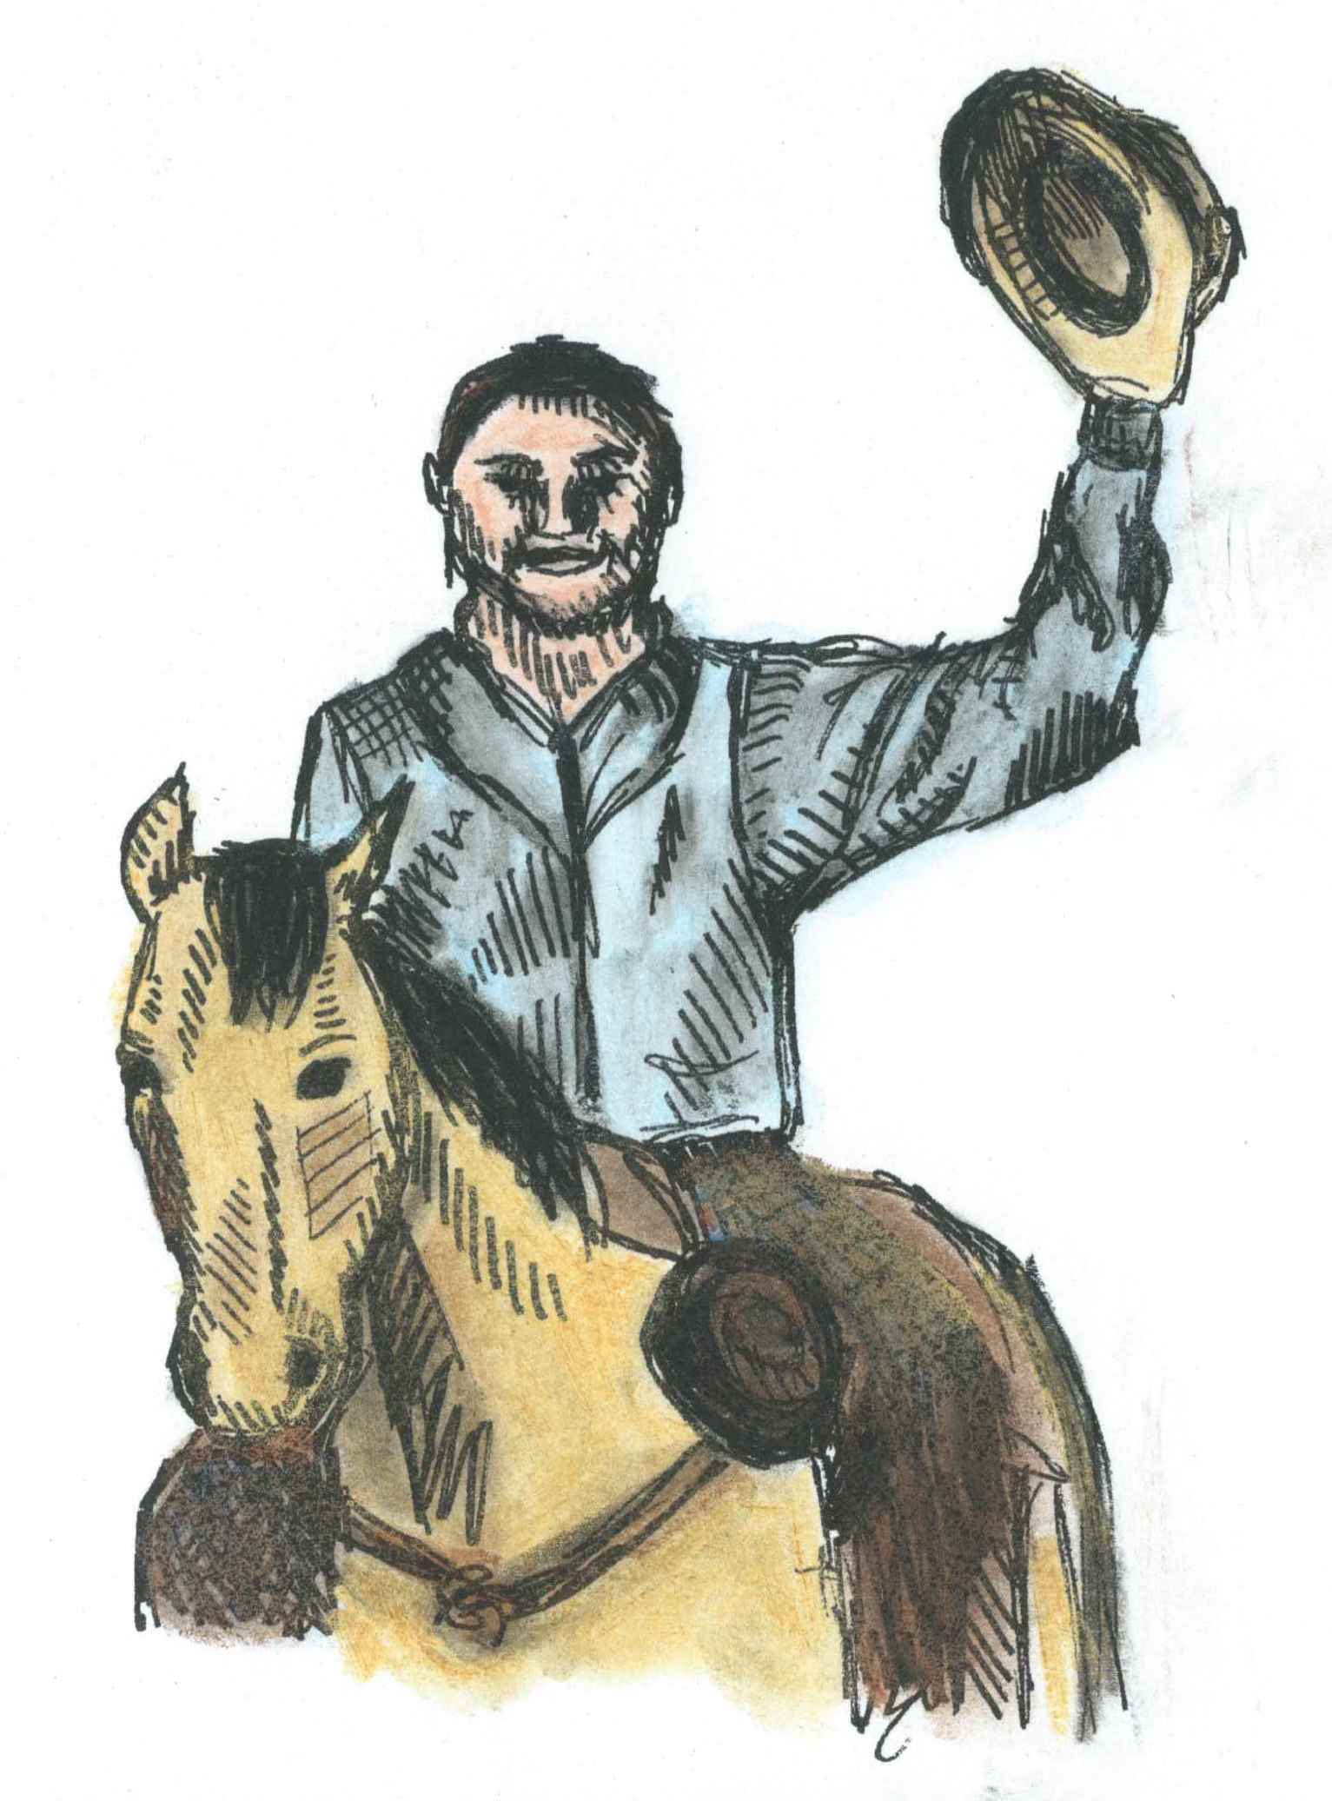
At the end of the day, when the rodeo is through, You’ll hear the music playing, Happy Trails to You. The fun may be over, but there really is more It will be back in a year, FOR SURE! Tell your family and friends, and then mark the time and date, So this way, next year, you won’t miss it or be late!

Slide 17
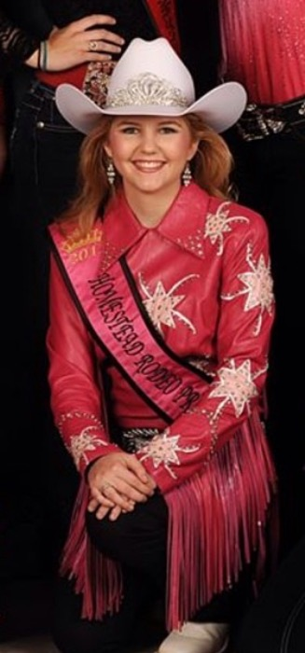
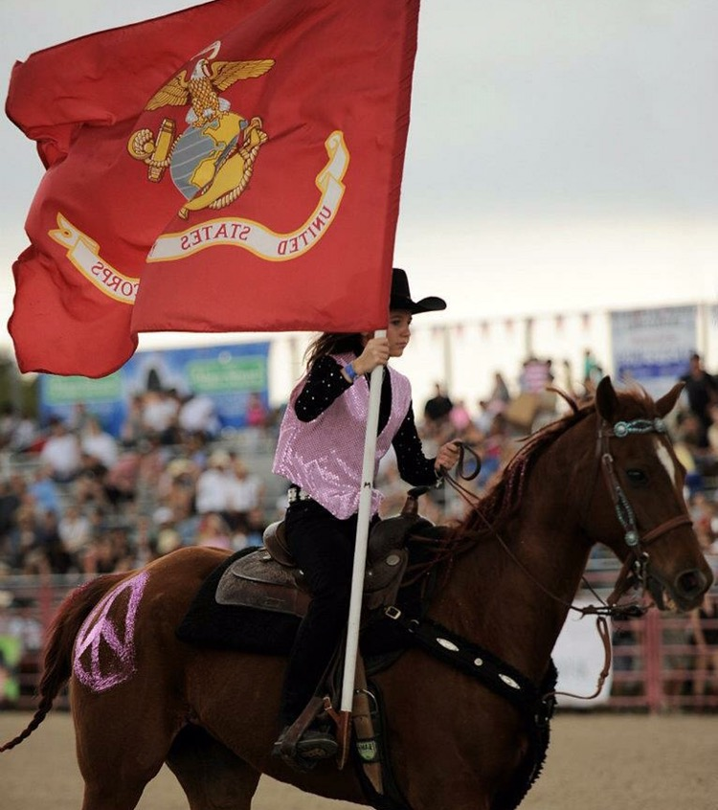
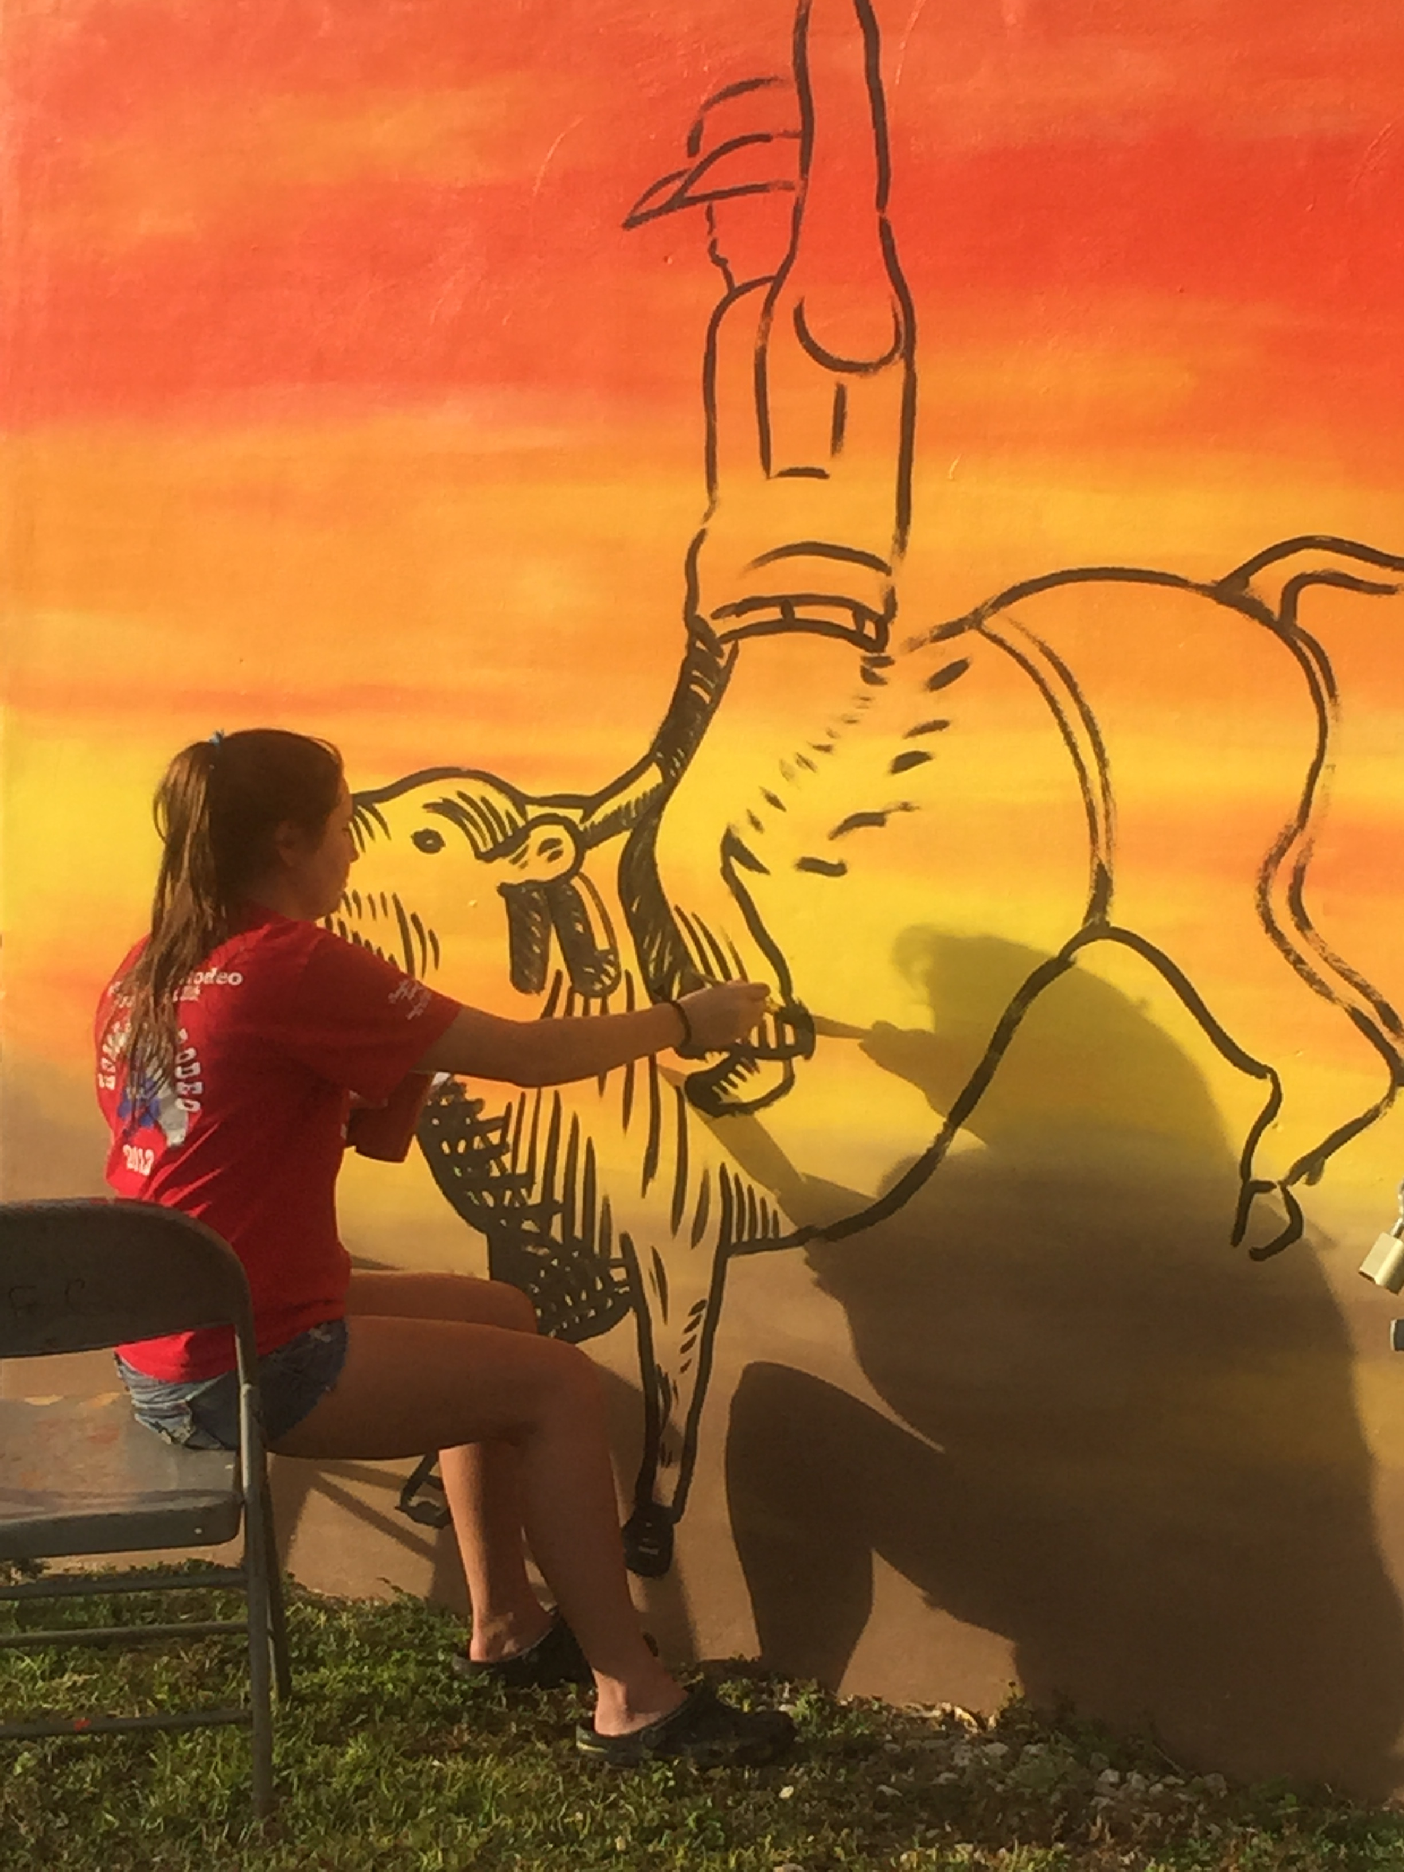
About the Author & Illustrator
Taylor Day Pearce was a senior at Coral Reef Senior High School in the Visual and Performing Arts Academy when she completed this book. This book was the culminating project for her Girl Scout Gold Award created for the Homestead Rodeo Association’s Books & Broncs Literacy Project. It was hoped the book will help raise awareness to all the children living
in the big city of Miami and the
surrounding cities about the annual
rodeo in Homestead, Florida.
Taylor has a deep connection with
Rodeo. She previously rode on the
Homestead Everglades Posse
Mounted drill team and was Rodeo
Princess for the year 2013.
Next time you attend the rodeo,
made sure you notice the mural on
the back of the office. The mural was
an inspiration spurred on from her
book Let’s Rodeo! Since high school,
Taylor is attending college at
Florida Gulf Coast University to study
Art and Creative Writing.

Slide 18
Additional Information
For further information, future lessons, and other sources about rodeo life, please feel free to visit www.SouthernInstructionalSolutions.com OR www.homesteadrodeo.com OR www.HomesteadRodeo.com
If you would like to make any donations for the Books & Broncs Literacy Project, please email SouthernInstructionalSolutions@aol.com or the Homestead Rodeo Association President at www.HomesteadRodeo.com (click the ‘Contact Us’ tab at the top of the homepage).
Your donation will help to support any of the follow activities: real horses visiting students at school, a copy of the printed book, Let’s Rodeo!, materials for the teachers to incorporate into their lessons, and/or busses for the students to come to the rodeo arena for the day to experience rodeo life.

